Slide 1


Vehicle Requisition System
A Software to make the Vehicle Requisition process smarter

Slide 2
Contents
Introduction
Audience / market
How the program will work
Project partners
Website Overview

Slide 3
Introducing: a new software program
A tool for simplifying Vehicle Requisition Process and to reduce time consumption .
Primarily for employees who wants to request for a vehicle for requisition .
Using MVC platform and computerized automated technologies .
It reduces the need for paper works .
Developed by a team of BKIICT students .

Slide 4
Audience / market
Primarily for the Bangladesh Computer Council (BCC) to manage a large number of vehicles requisition process.
Also useful for –
Another Organizations to provide same vehicle requisition facilities .
Organizations with a huge number of Vehicle in their Vehicle pool can also maintain their regular vehicle and driver related works with so much simplicity .
Organizations who want to make the rent/requisition process smarter.

Slide 5
How the progam will work
It is a web based application .
Employee request for requisition using their web browser through internet .
A controller will get the request through internet and will assign a vehicle against the request .
After successful vehicle assigning process system will send notification to the requester and the driver through Email and also in our website .
Controller, employee and driver can also communicate with each other against any requisition during different state of requisition . It will eliminate communication gap between each other.

Slide 6
Project partners
BKIICT
BCC

Slide 7
Process flow
Request Submitted by Employee
Request sent to a Controller as a new Request
Respond of the Controller
Notification to request0r and driver
Assign

Slide 8
Website Overview

Slide 9
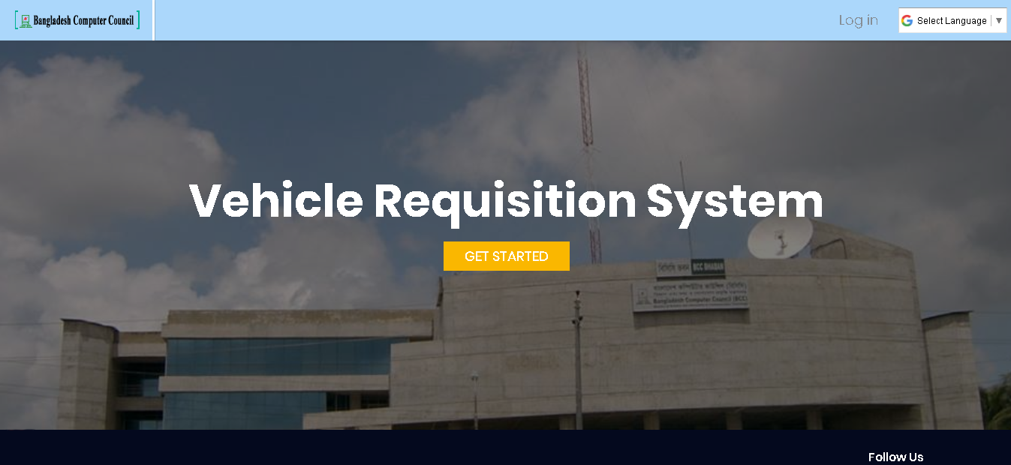
Login-page

Slide 10
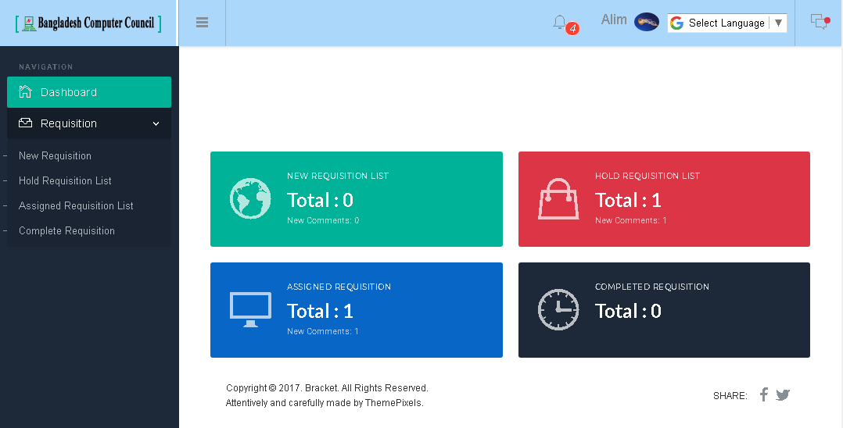
Employee Dash Board

Slide 11
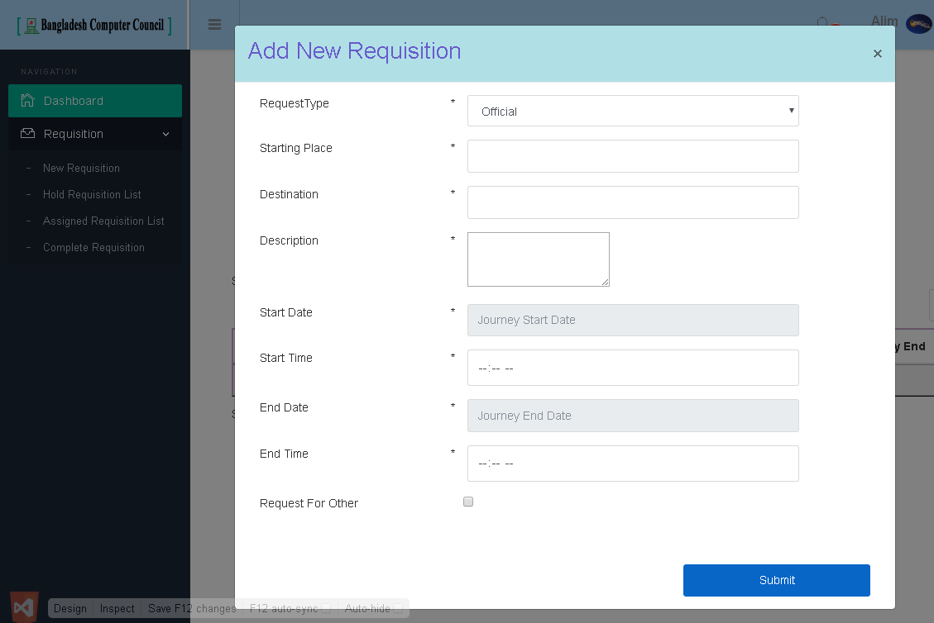
Requisition entry

Slide 12
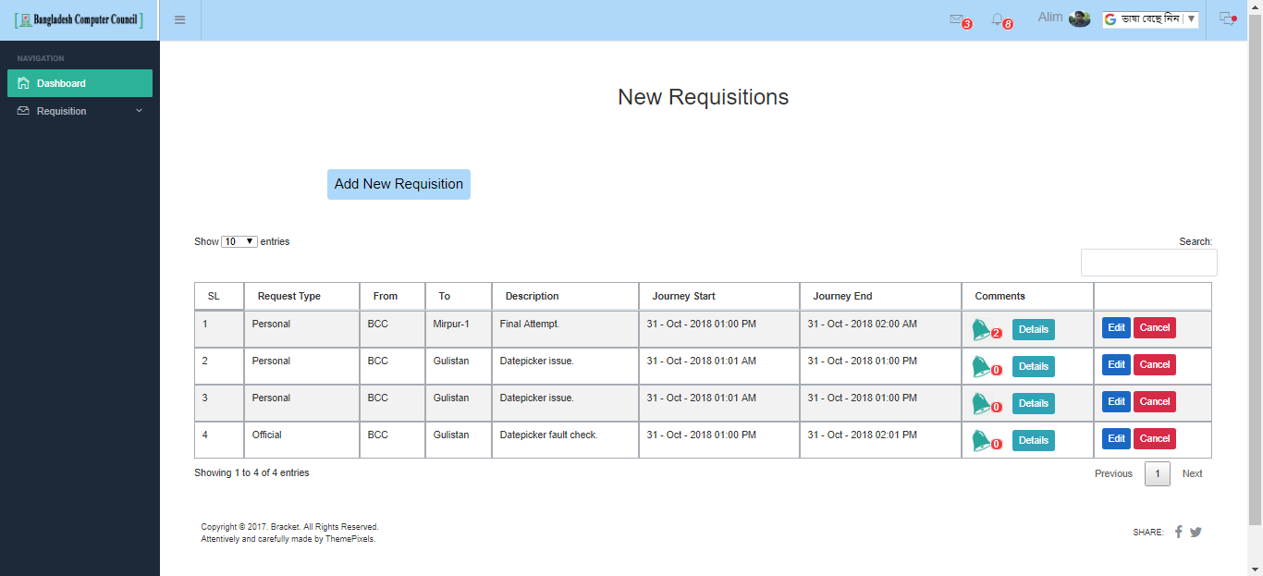
Employee’s New Requisitions List

Slide 13
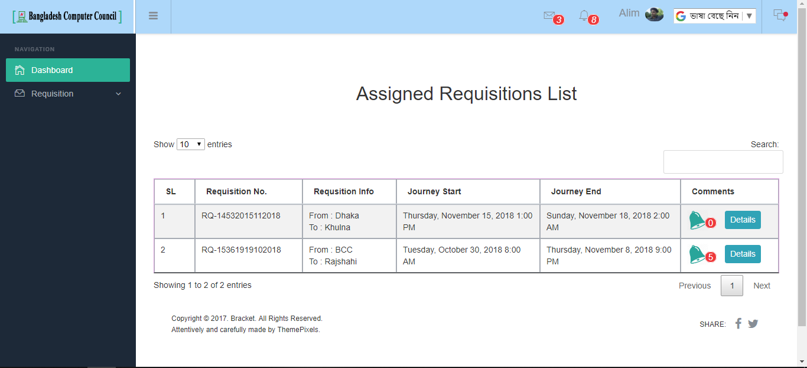
Employee’s Assigned Requisitions List

Slide 14
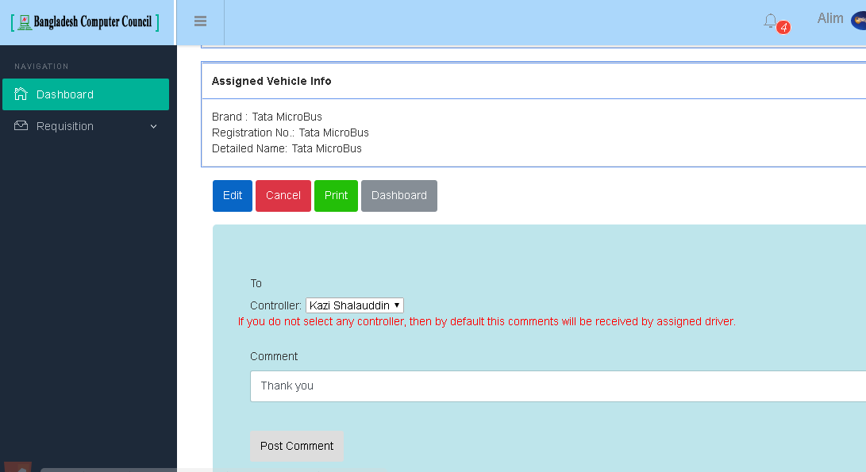
Feedback against requisition

Slide 15
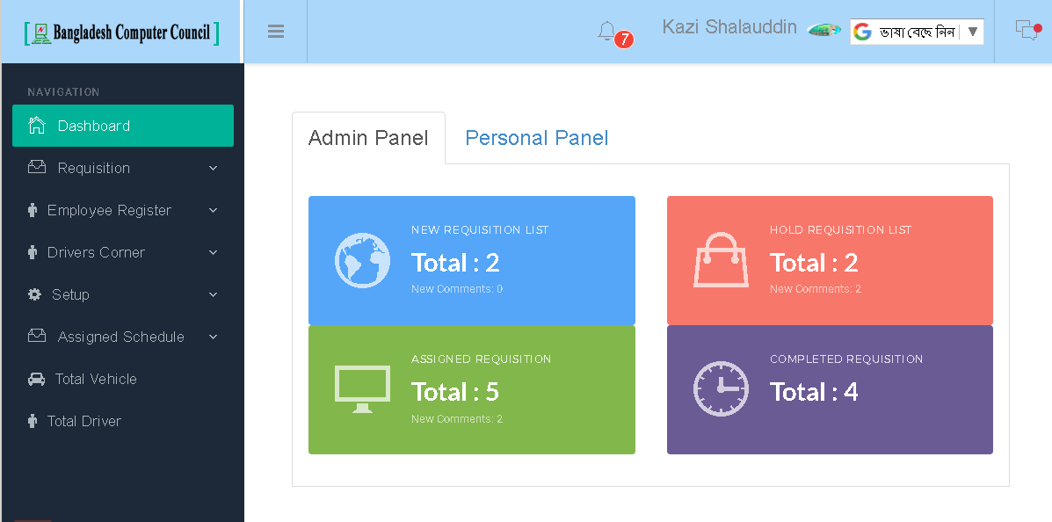
Admin Dash Board

Slide 16
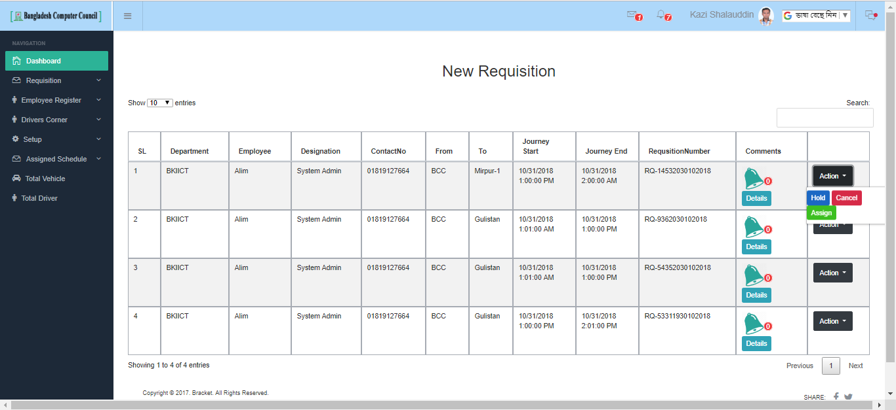
Admin Awaiting requests panel

Slide 17
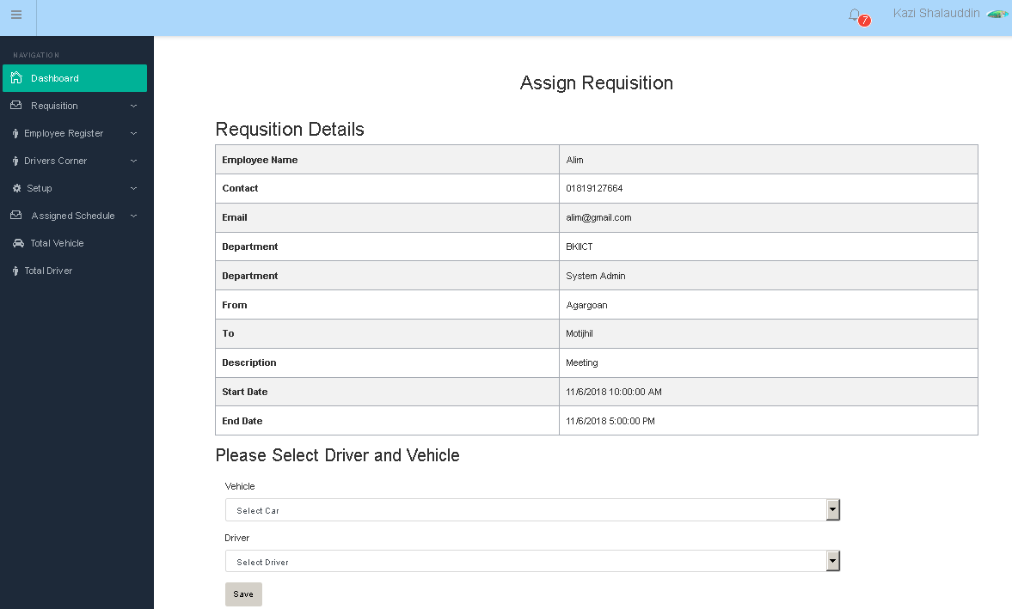
Admin requests assigning panel

Slide 18
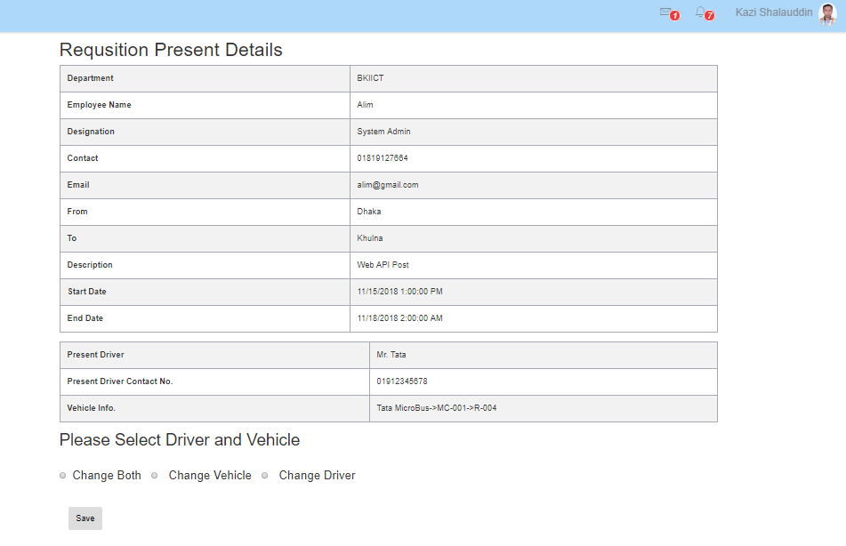
Admin request Reassigning panel

Slide 19
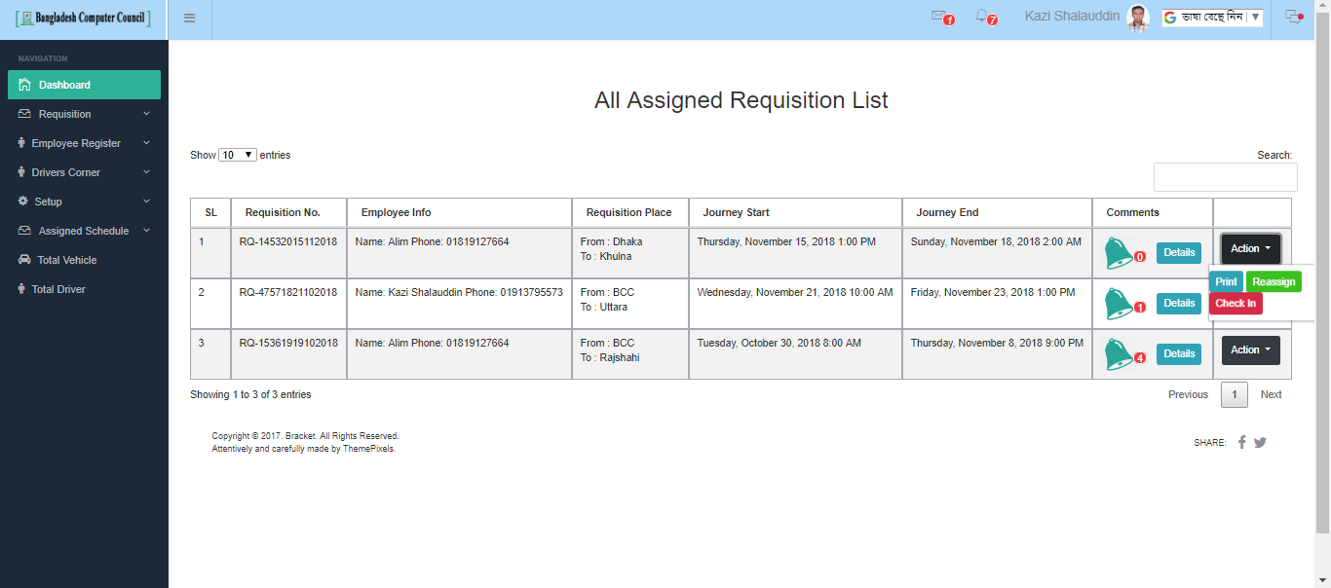
Admin assigned requisitions list

Slide 20
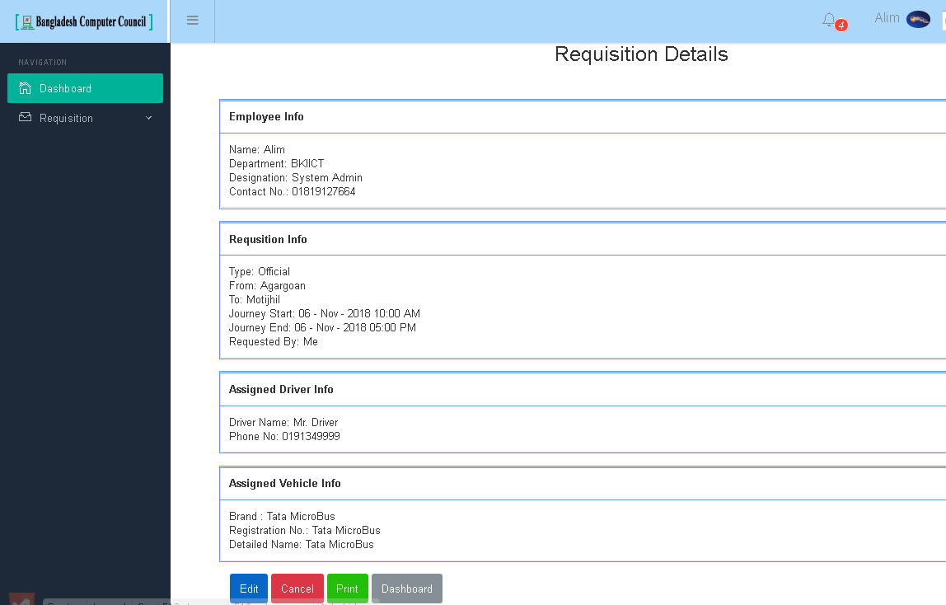
Assigned Requisition Details

Slide 21
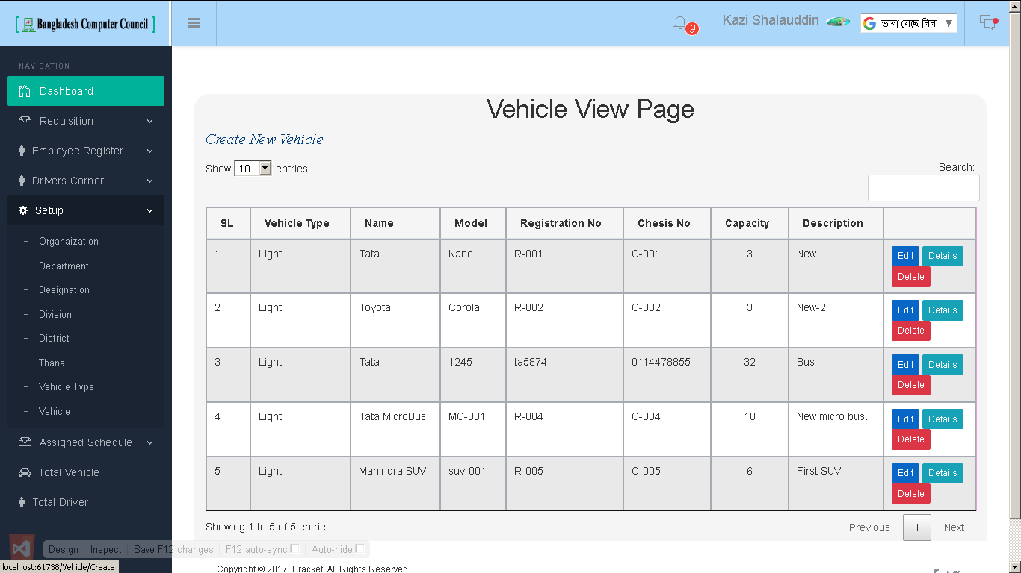
Administrative setup page

